Slide 1

Amazon Review Data
Ra'Shawn Howard

Slide 2
Variables descriptions
Response: Polarity is constructed by taking review score 1 and 2 as negative, 4 and 5 as positive. Samples of score 3 are ignored. In the dataset, class 1 is the negative and class 2 is the positive.
Predictor: Review text

Slide 3
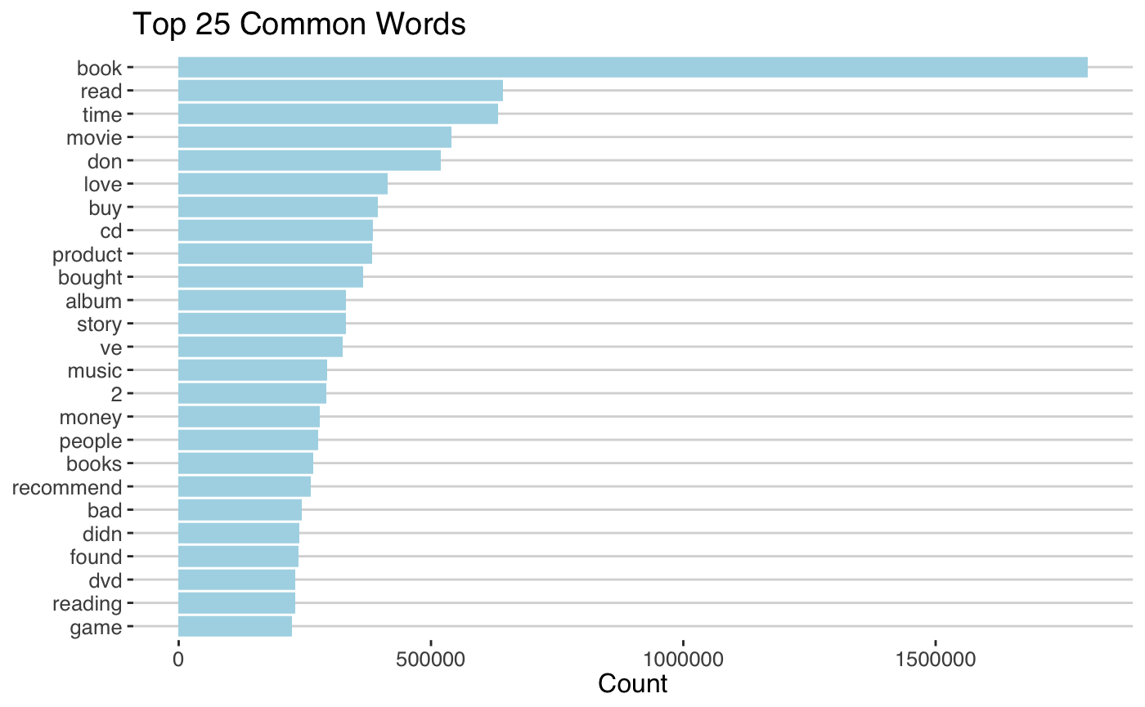
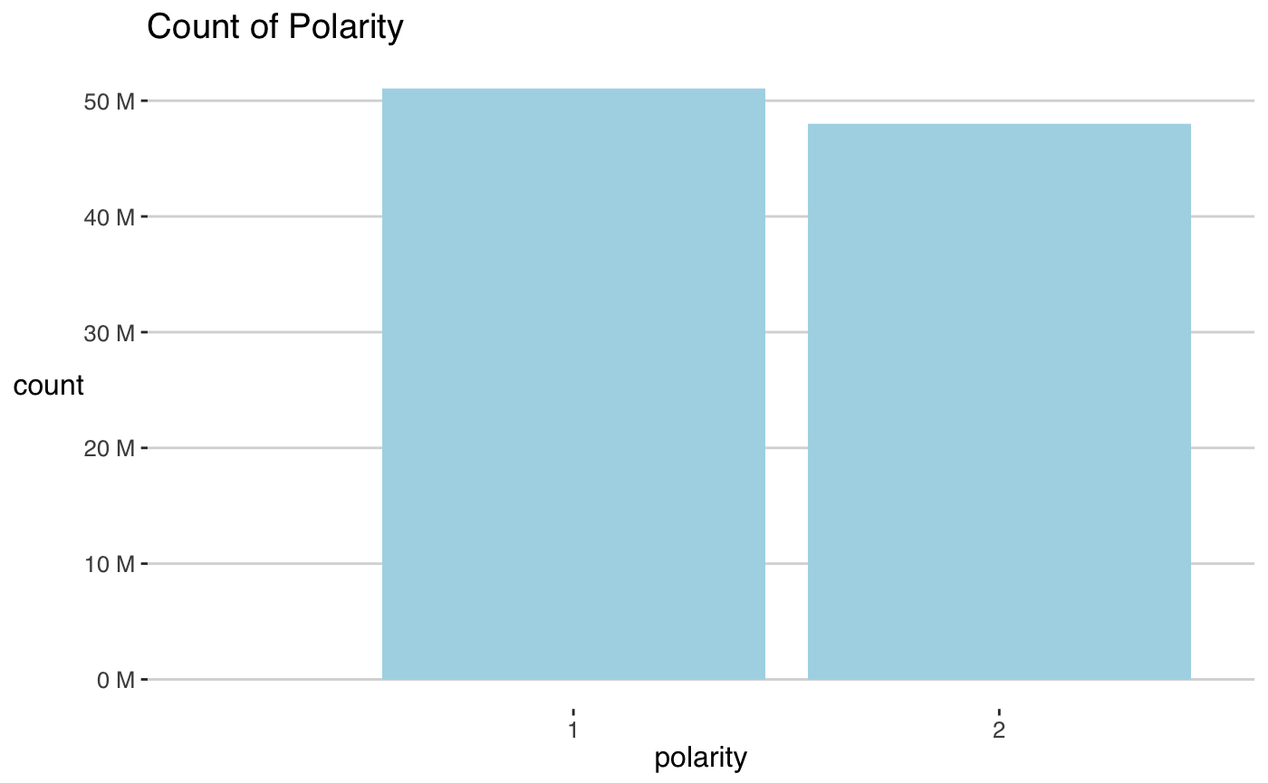
Descriptive statistics

Slide 4
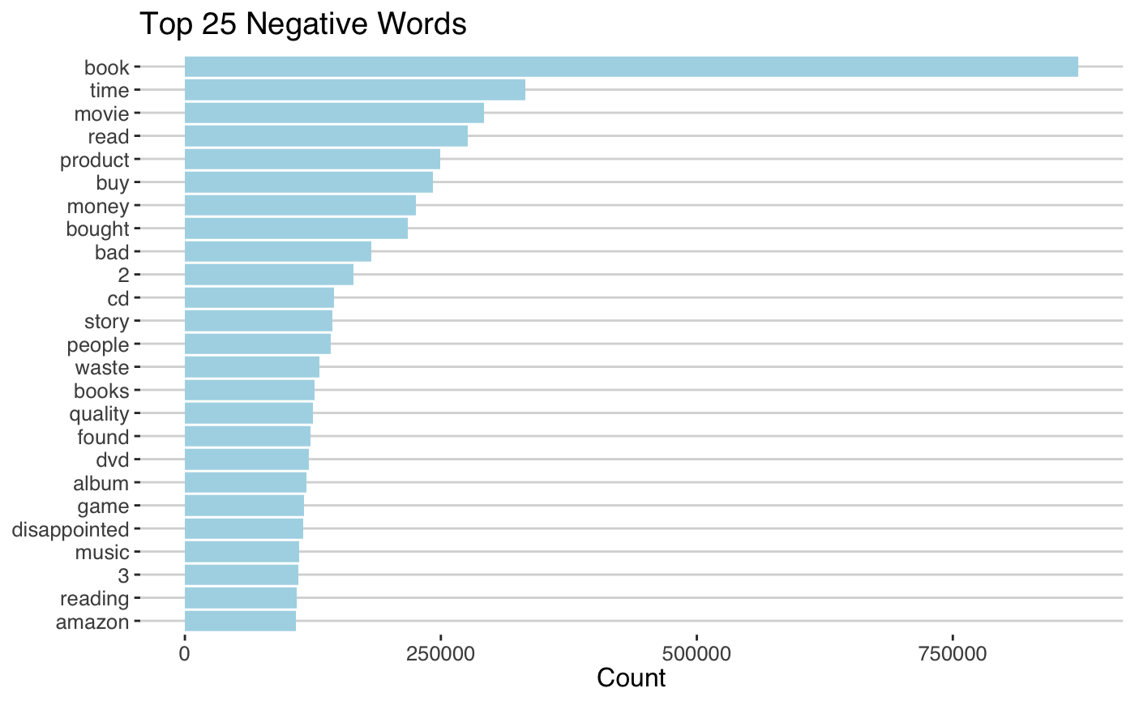
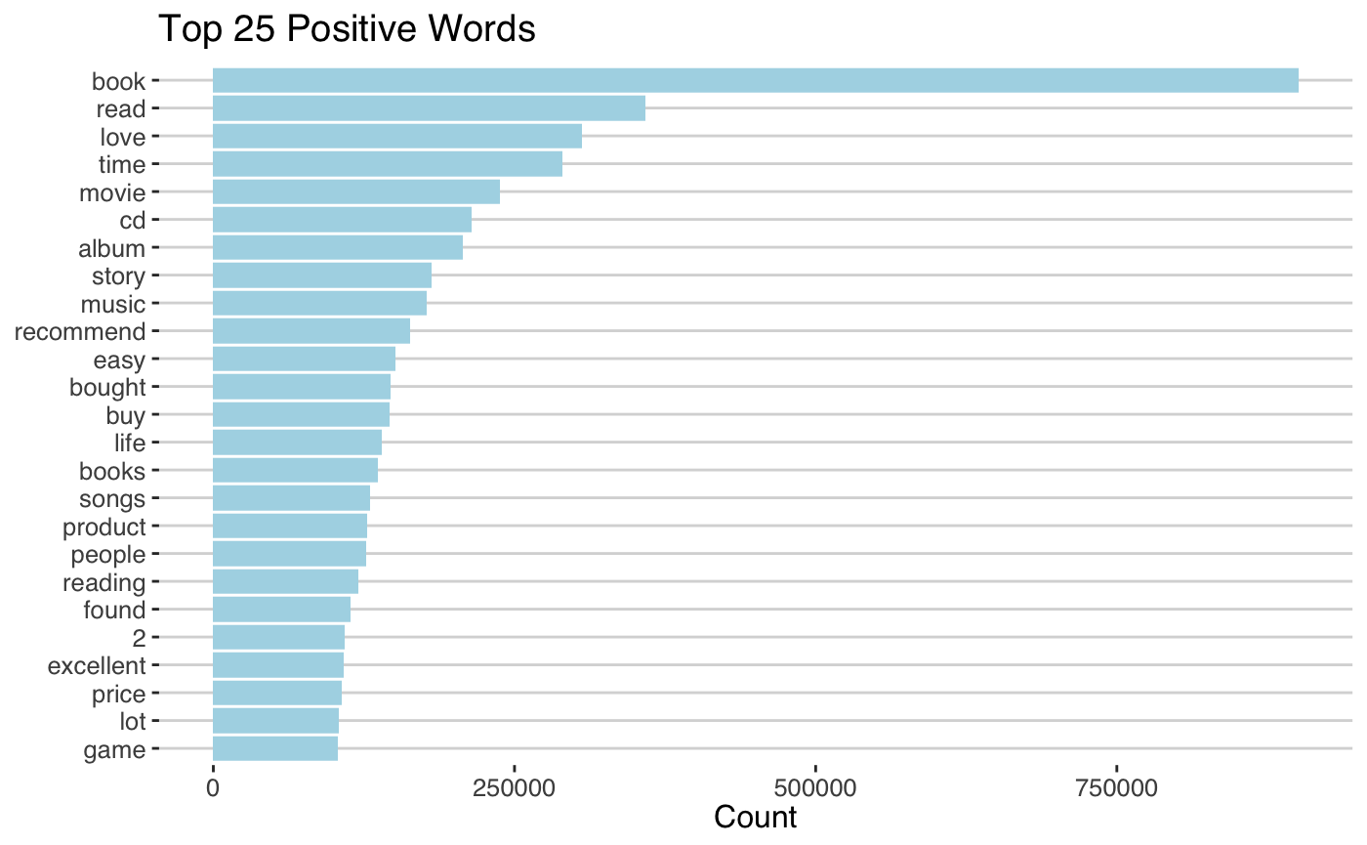
Descriptive statistics

Slide 5
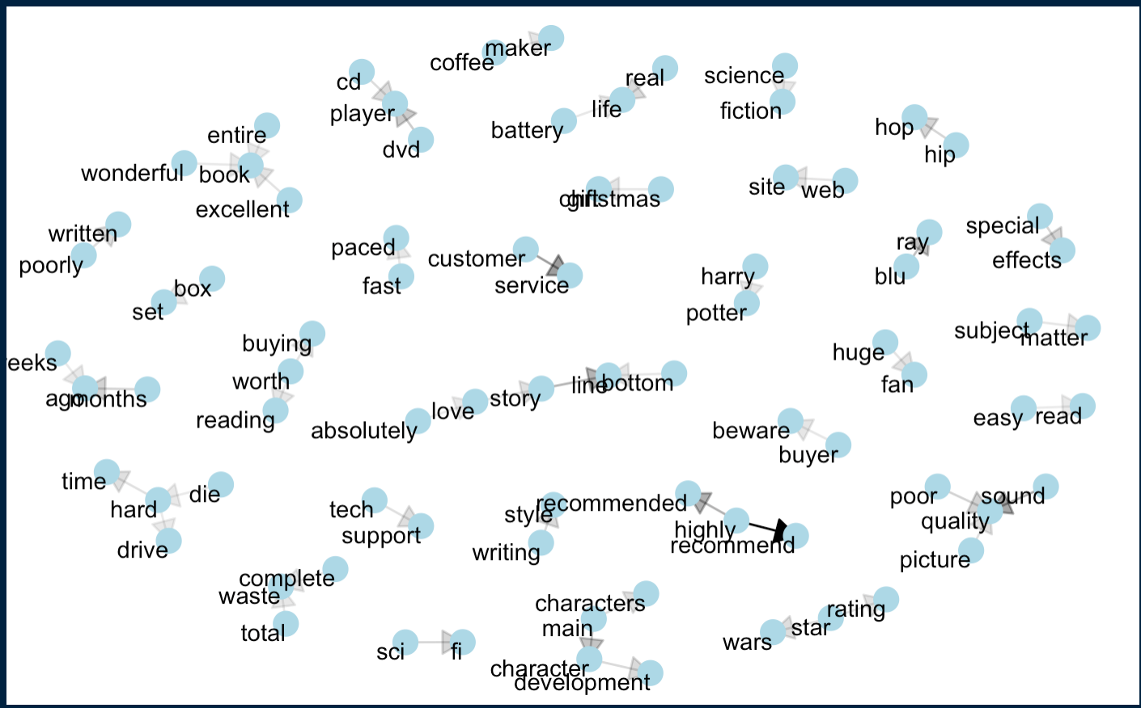
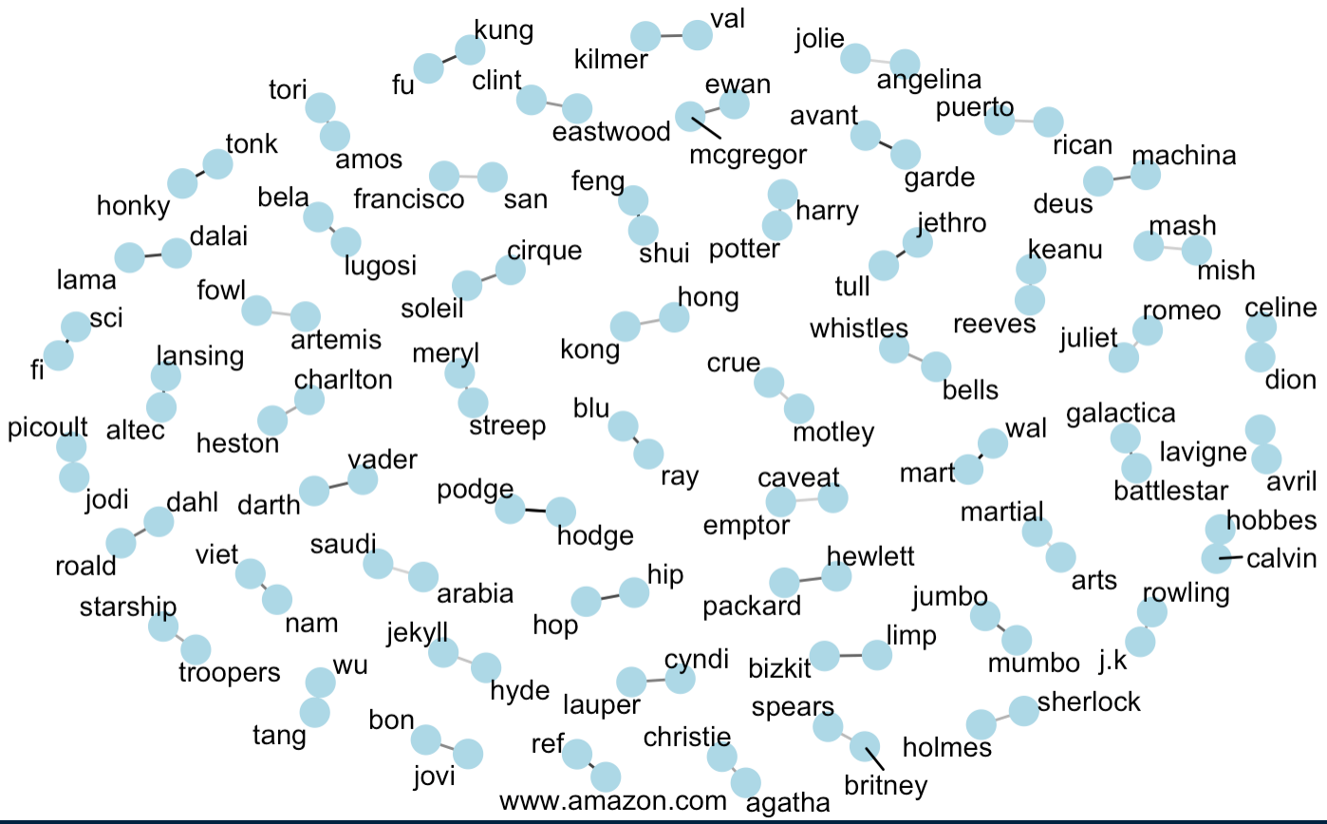
Correlation

Slide 6
Knowledge GAP
BERT Large
DPCNN
DRNN
EXAM
SRNN
FastText
BERT Large Finetune UDA
CCCapNet

Slide 7
BERT MODEL
BERT (Bidirectional Encoder Representations from Transformers) is a Natural Language Processing Model proposed by researchers at Google Research in 2018. When it was proposed it achieve state-of-the-art accuracy on many NLP and NLU tasks

Slide 8
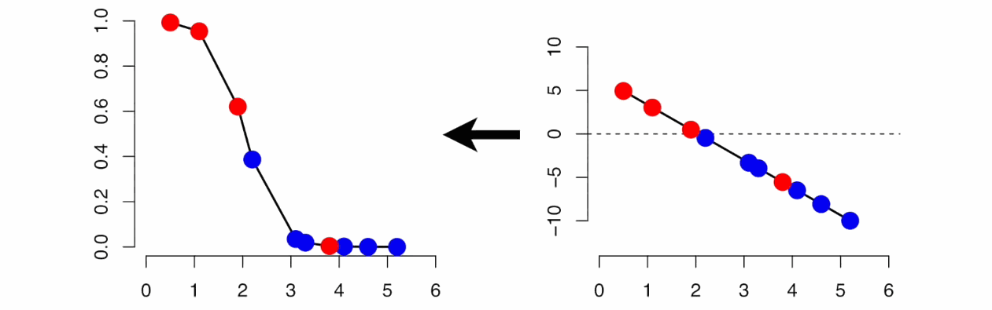
Current knowledge.
Simpler models 😁 In particular for binary classification logistic regression

Slide 9
Research questions
Can I use review text to predict if a reviewer is giving high stars or low stars?
How does my model compare to the top prediction models already done on this dataset?
What gives a higher prediction tf or tf_idf?

Slide 10
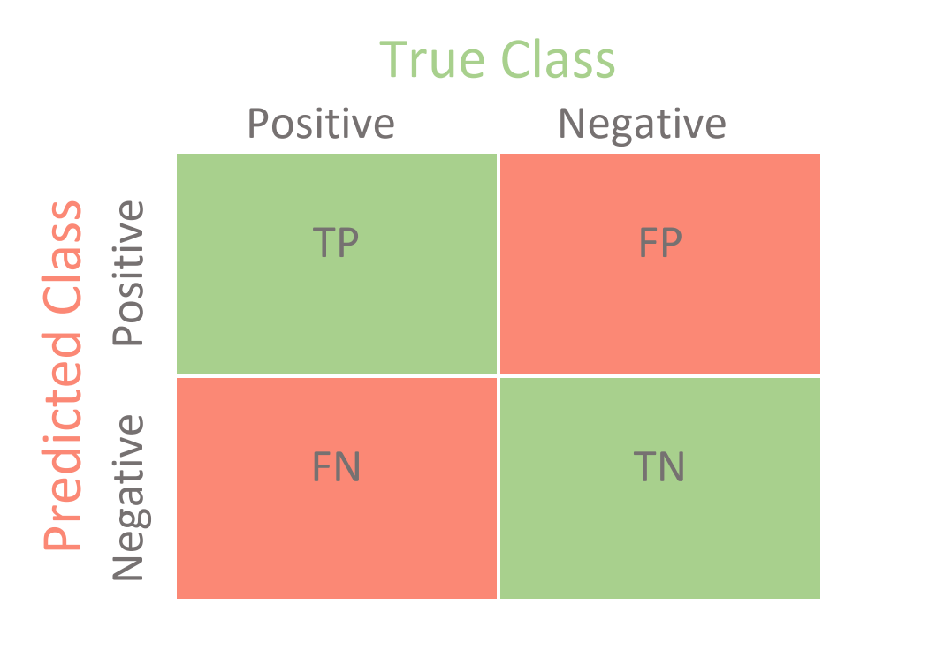
ASSESSMENT METRICS
Accuracy shows us how comfortable the model is with detecting the positive and negative class. Precision tells us about the success probability of making a correct positive class classification. Recall explains how sensitive the model is towards identifying the positive class.
Accuracy = [TP+TN]/Total Population
Precision = TP/[TP+FP]
Recall = TP/[TP+FN]

Slide 11
Precision vs recall
Precision answers: When model predicted TRUE how often was it right?
Recall answers: When the class was actually TRUE how often did the classifier get it right?

Slide 12
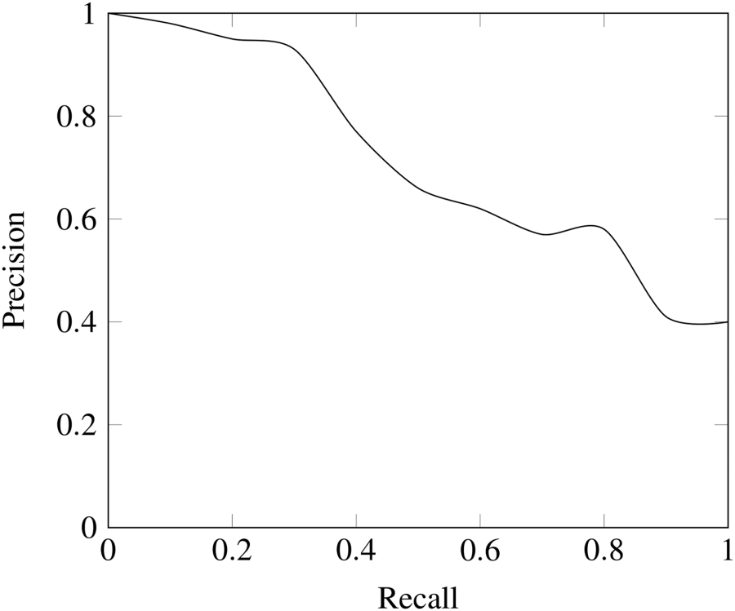
Precision recall trade off

Slide 13
F-metric
Alone, neither precision or recall tells the whole story. We can have excellent precision with terrible recall, or alternately, terrible precision with excellent recall. F-measure provides a way to express both concerns with a single score.
F-Measure = (2 * Precision * Recall) / (Precision + Recall)
Like precision and recall, a poor F-Measure score is 0.0 and a best or perfect F-Measure score is 1.0

Slide 14
Roc AUC
It tells how much the model is capable of distinguishing between classes. Higher the AUC, the better the model is at predicting 0 classes as 0 and 1 classes as 1.
When AUC is approximately 0.5, the model has no discrimination capacity to distinguish between positive class and negative class.

Slide 15
What effects model Accuracy
Model
Preprocessing
Grid search
Number of words used
Ngram choice
Tf vs tf_idf

Slide 16
Expected outcome
Having a comparable model to BERT or other NN model, with a much simpler model.
1

Slide 17
TF vs TF_idf
Two different ways to convert the words into weights
TF- term frequency is how frequently a word occurs in a document.
IDF- inverse document frequency decreases the weight for commonly used words and increases the weight for words that are not used very much in a collection of documents.
This can be combined with TF to calculate TF_IDF by multiplying the two quantities together.
TF_IDF can be described as the frequency of a term adjusted for how rarely it is used.
IDF = ln(n_documents/n_document_containing_term)

Slide 18
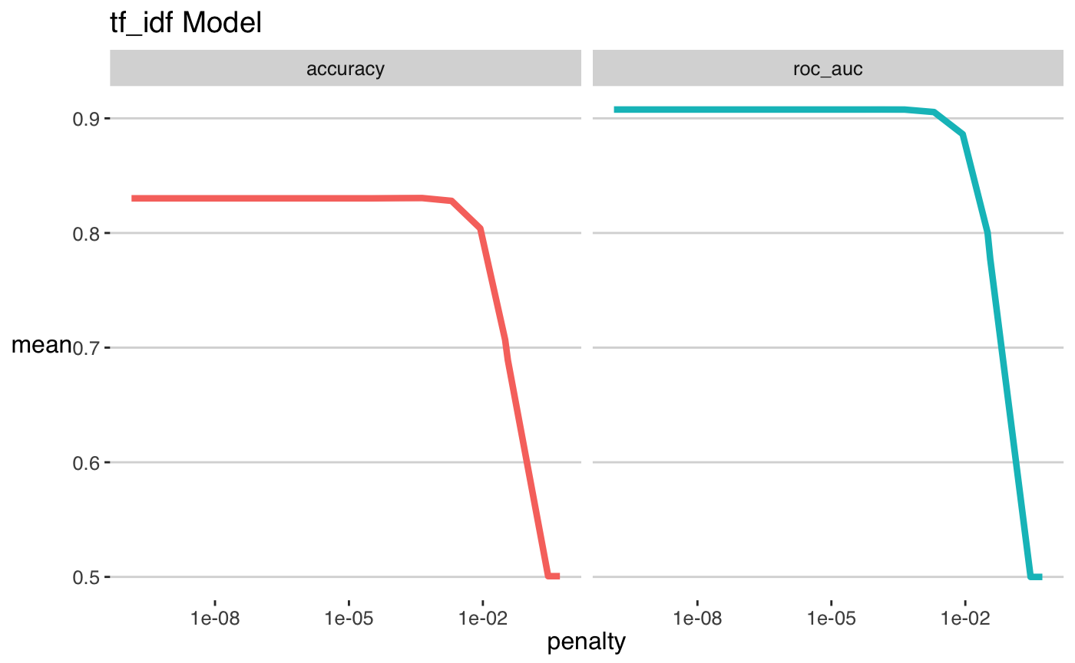
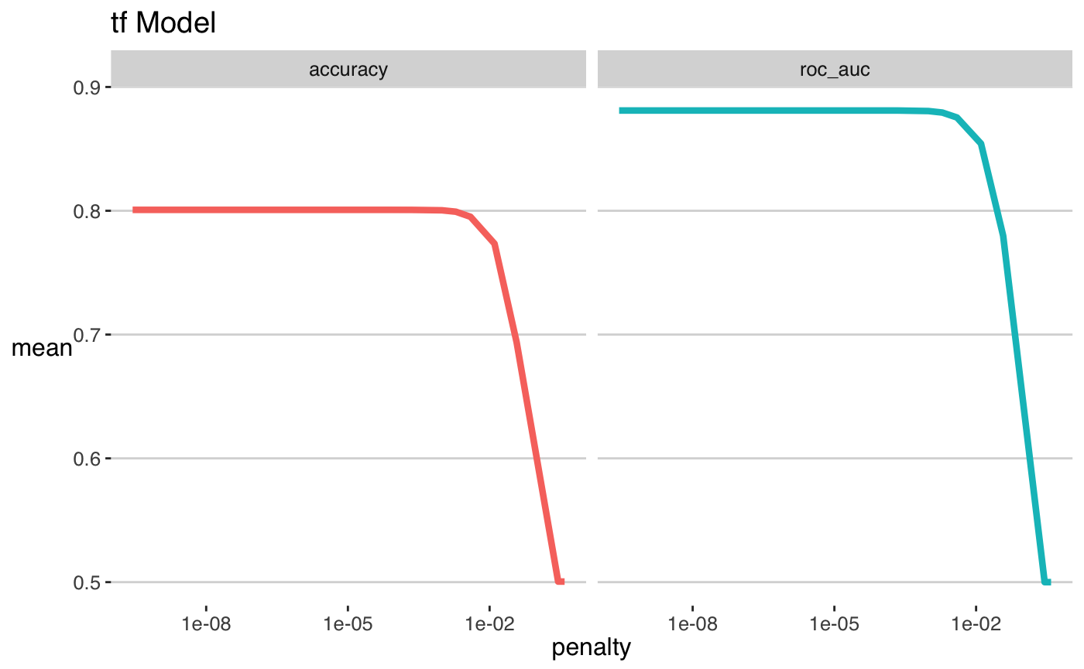
How Each performed

Slide 19
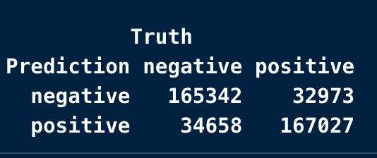
Testing on new data
Accuracy = 83.09%
Precision = 82.82%
Recall = 83.51%

Slide 20
Conclusion
We can use review text to predict if a reviewer is giving a product high or low stars.
My model doesn’t compare to the top models in terms of accuracy
TF_IDF performed slightly better than TF on the training data

